Slide 1


Money Cashboard project
My experince

Slide 2
Project requirements
Consolidate learning of the following aspects:
Ruby fundamentals
TDD (test driven development)
OOP- Web Programming ( REST/MVC )
Databases with CRUD actions

Slide 3
Project brief
tracking your spending in an attempt to be more frugal with money.
make a budgeting app to help you see where all of your money is being spent.
create new Transactions ( which should include a merchant name, e.g. Tesco, and a value ) which have an associated Tag (e.g. 'food', 'clothes'). be able to track a total, and display this in a view
Create new transactions
Display a list of all transactions
Display total amount spent
Display total amount spent by tag

Slide 4
planning
Started off by having a group planning session where we captured and discussed viable methods for completing the tasks.
User needs, class diagrams, & table diagrams were drawn on a whiteboard & we discussed the pros and cons of each suggested solution.
We ended up agreeing on creating three tables as follows:
1: Transactions
2: Merchants
3: Tags.
Models based on the above tables and associated methods were also agreed.

Slide 5

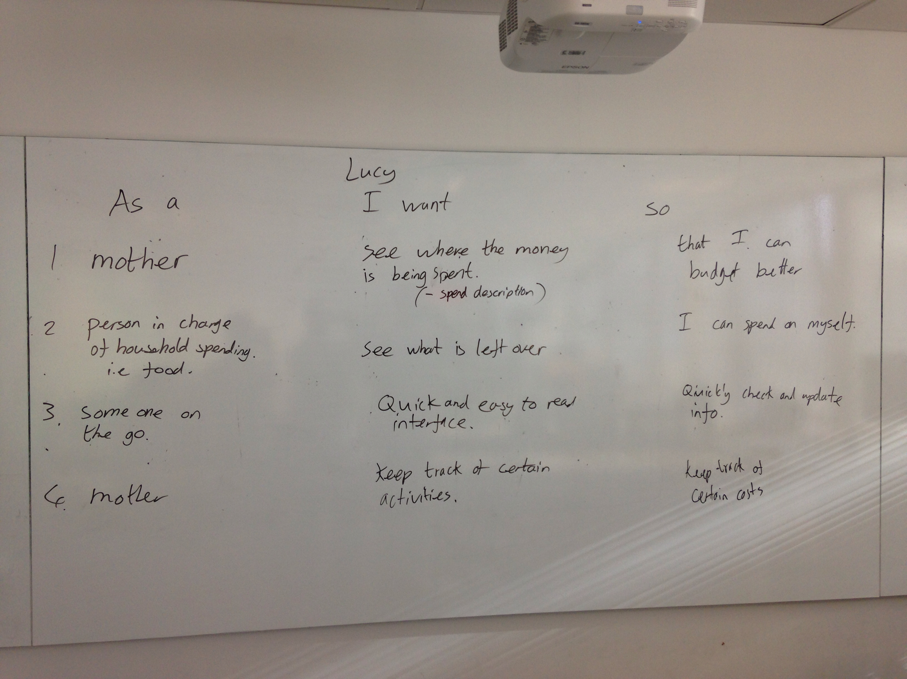
User needs for lucy

Slide 6
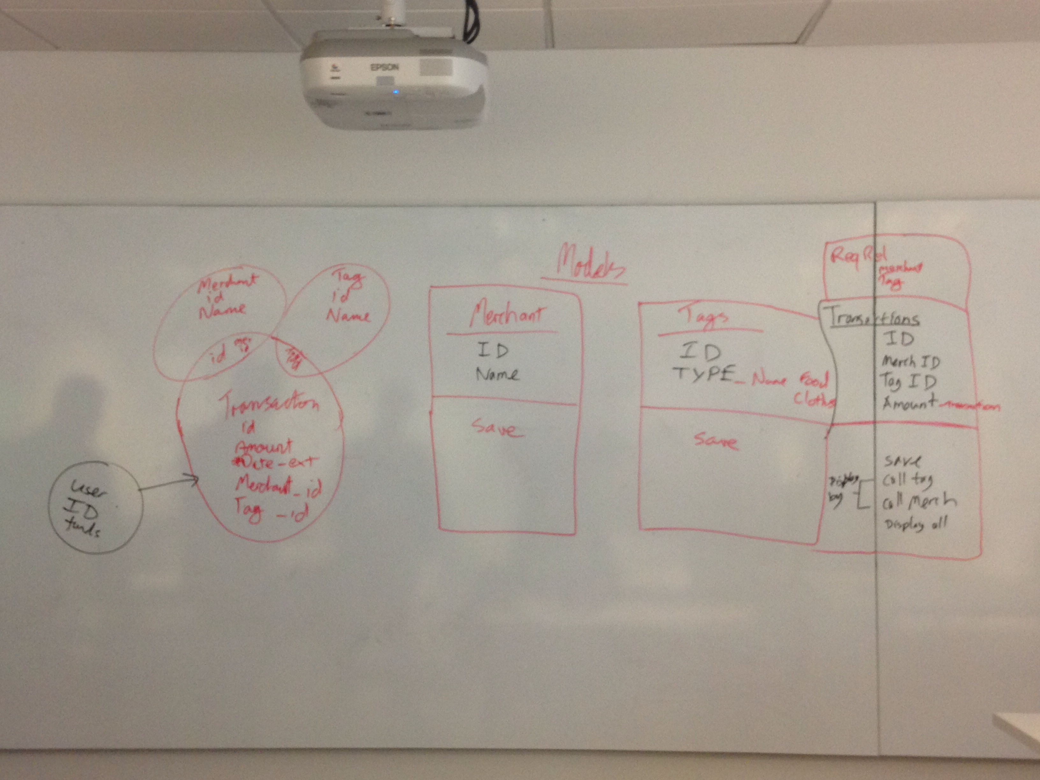
Classes & table venn diagrams

Slide 7
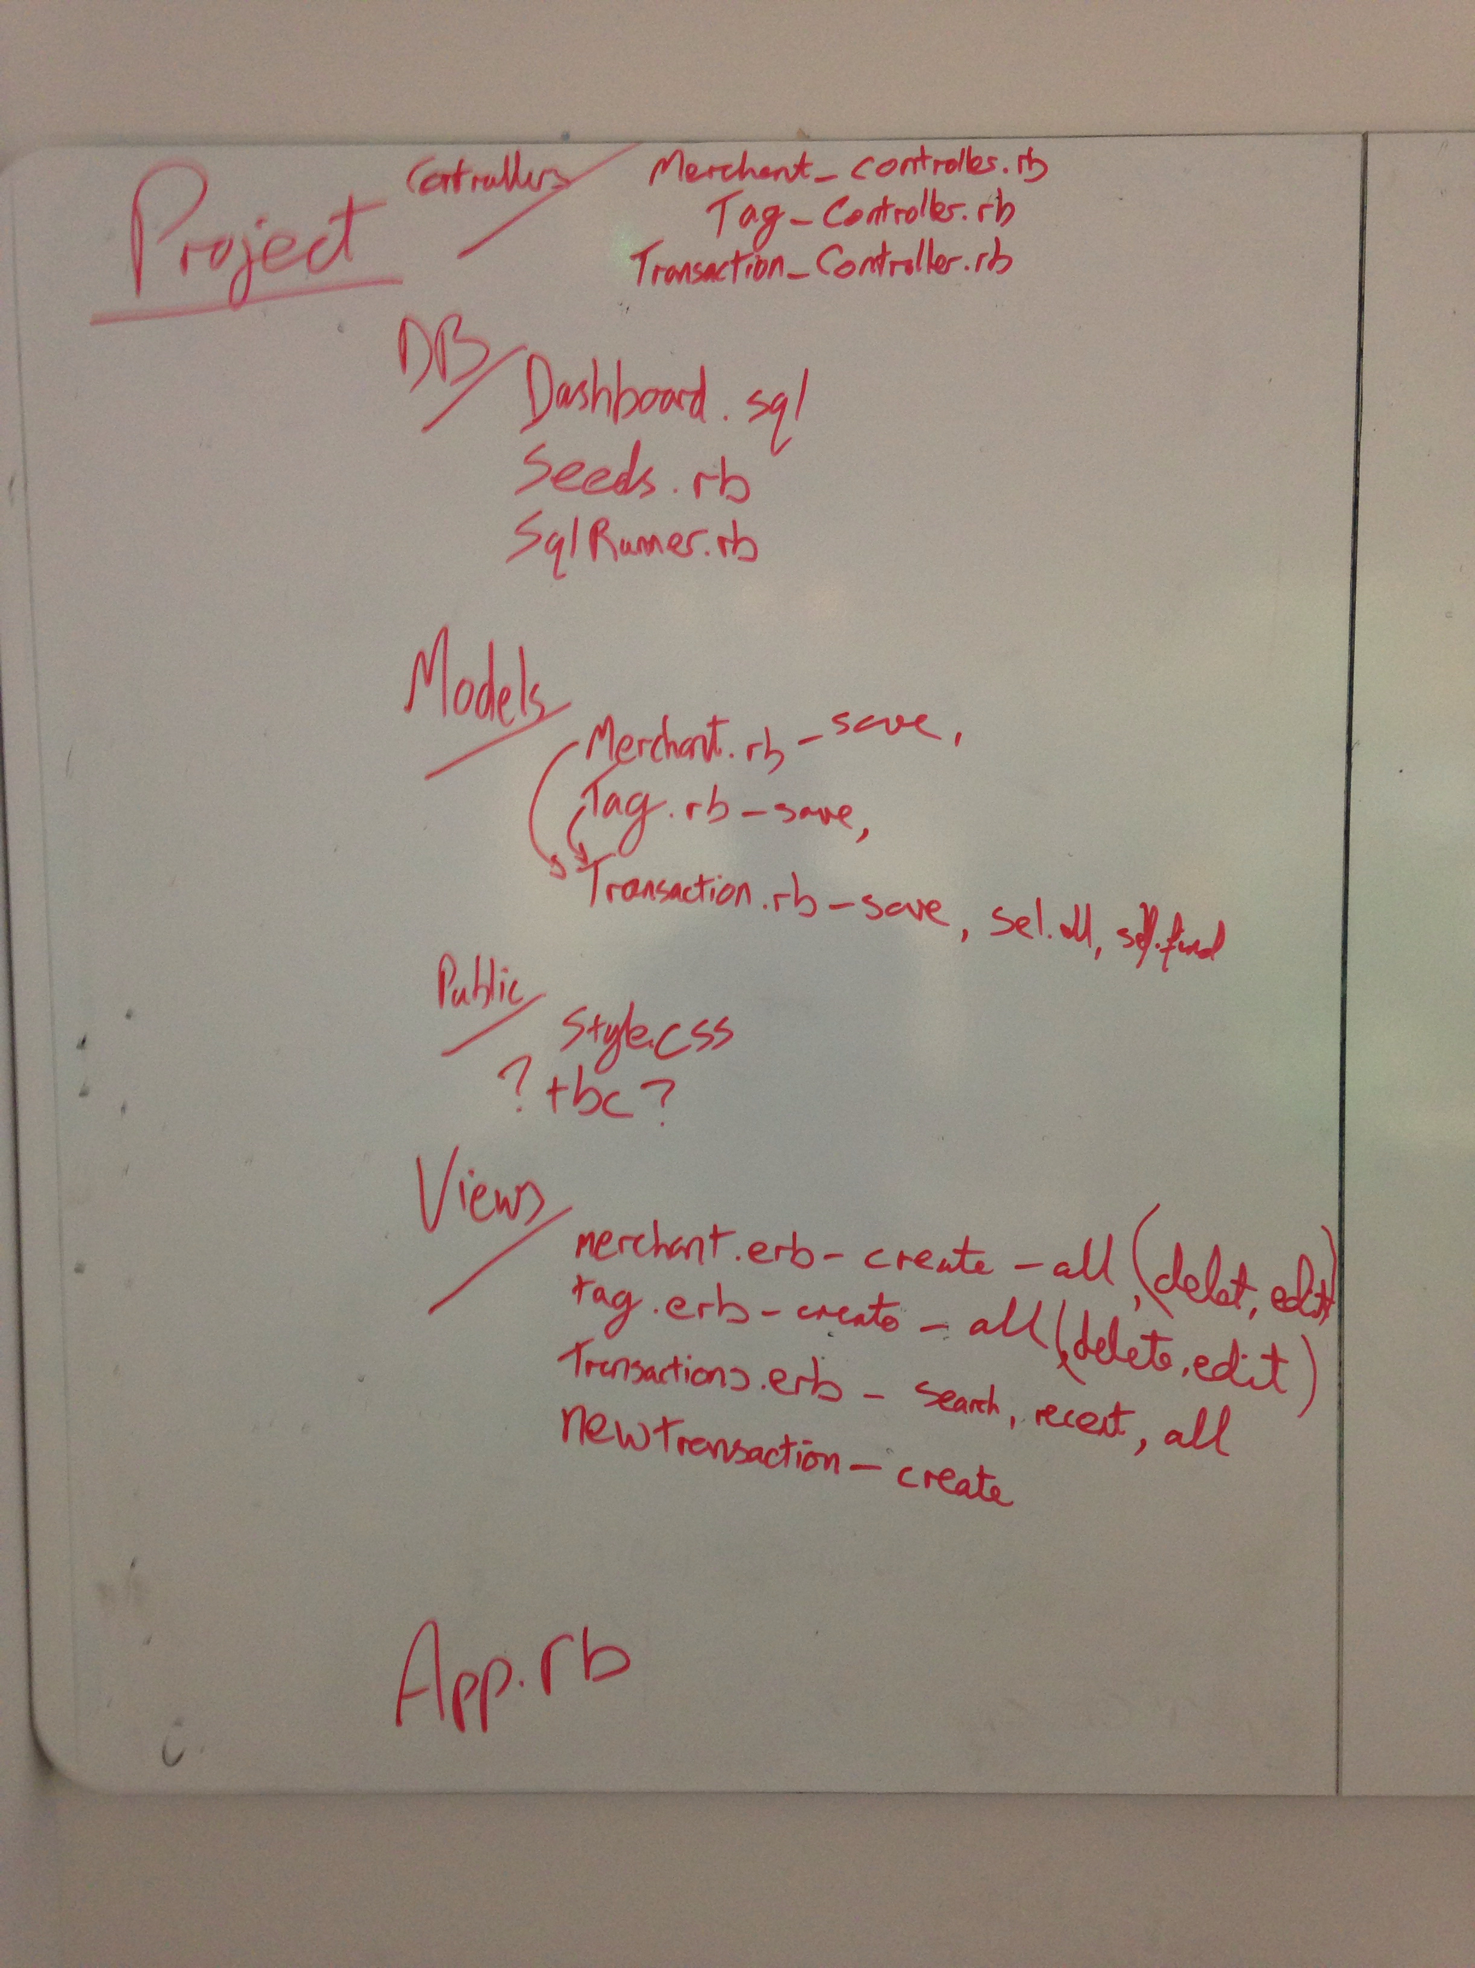
Directory structure

Slide 8
My experience
Basic directory structure set-up first of all.
I Created database and tables as outlined in the plan.
I Created models and some crud for the transactions model. This was followed by populating my seeds file, and I started testing using pry and psql in the terminal.
I then Started working on controller and views for transactions, and eventually managed to get some information displaying in the browser.
A similar method was followed for the merchants and tags tables, until I had all the information viewable in the browser.
The final step was some minimal styling with Css.
Notes:
I was the happiest man on the planet when my tables showed data.

Slide 9
opportunities
I had many opportunities to improve my understanding of ruby, sinatra and databases during the course of the project.
The first opportunity came when I was struggling to get a total amount spent PER TRANSACTION in my transactions model. I had decided to try a reduce method, but I couldn’t get it to work. After spending some time on it I DECIDED TO LOOK INTO USING SQL INSTEAD. I FOUND I COULD USE SUM, AND AFTER SPEAKING TO THE OTHER GUYS, I FOUND THAT THEY HAD DECIDED TO GO DOWN THE SAME ROUTE. SO, WITH SOME HELP I EVENTUALLY MANAGED TO CREATE A METHOD TO GET BACK THE TOTAL.
I ALSO NEEDED TO CREATE METHODS TO RETRIEVE THE TOTALS by tag name and by merchant, WHICH I BELIEVED REQUIRED THE USE OF INNER JOINS. I MANAGED TO GET THESE WORKING AND LATER IN THE PROJECT FOUND OUT THAT INNER JOINS WERE NOT REALLY REQUIRED. THANKS CALLUM!!!

Slide 10
OPPORTUNITIES CONT.
The next opportunity came whilst I was trying to perform transaction updates via the browser. I had some problems with the transaction update form, since my tag table included an item name and item type, whereas my transaction model only included tag_id for inner joins. It was therefore not possible to update both the item name and the item type from the transaction update form. This required me to reformat my tags and transactions tables. Following this I eventually managed to create and update transactions.
THIS WAS A FANTASTIC OPPORTUNITY FOR ME TO LEARN HOW TO BREAK THINGS AND PUT THEM BACK TOGETHER AGAIN.
IT WAS GREAT FUN, AND NO SUPER GLUE WAS REQUIRED.

Slide 11
OPPORTUNITIES CONT.
HAD SOME ISSUES TRYING TO auto-populate the form with existing transaction data prior to updating. This caused me some problems when trying to do this for drop down items. I was shown a solution by one of the instructors.
I ALSO HAD TROUBLE TRYING TO GET THE TOTAL AMOUNT SPENT PER MERCHANT SHOWING IN MY MERCHANTS TABLE. THE TOTAL AMOUNT SPENT BY MERCHANT IS A METHOD OF THE TRANSACTION CLASS. I RECEIVED HELP FORM PETER ON THIS.

Slide 12
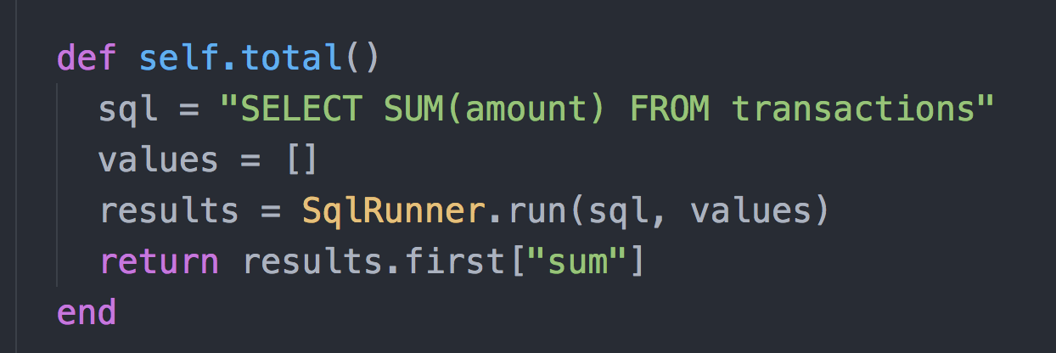
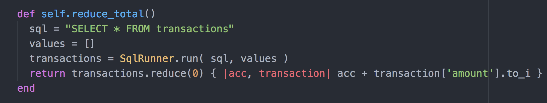
SOLUTIONS

Slide 13
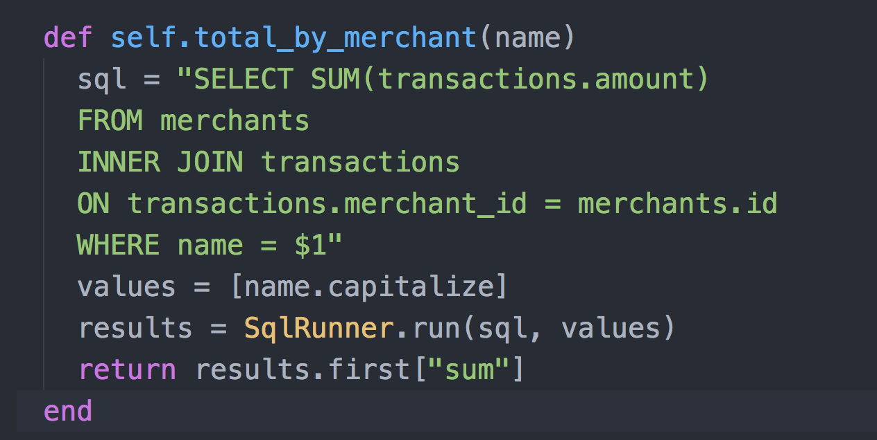
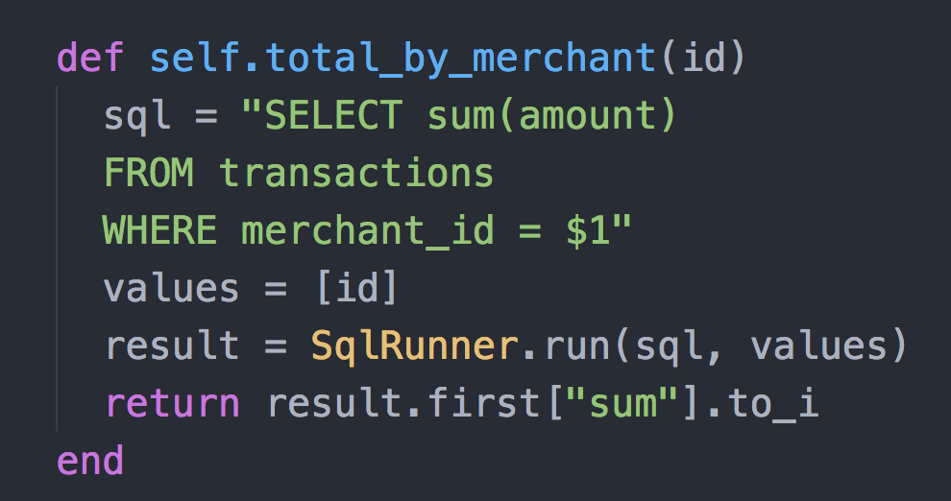
SOLUTIONS CONT.

Slide 14
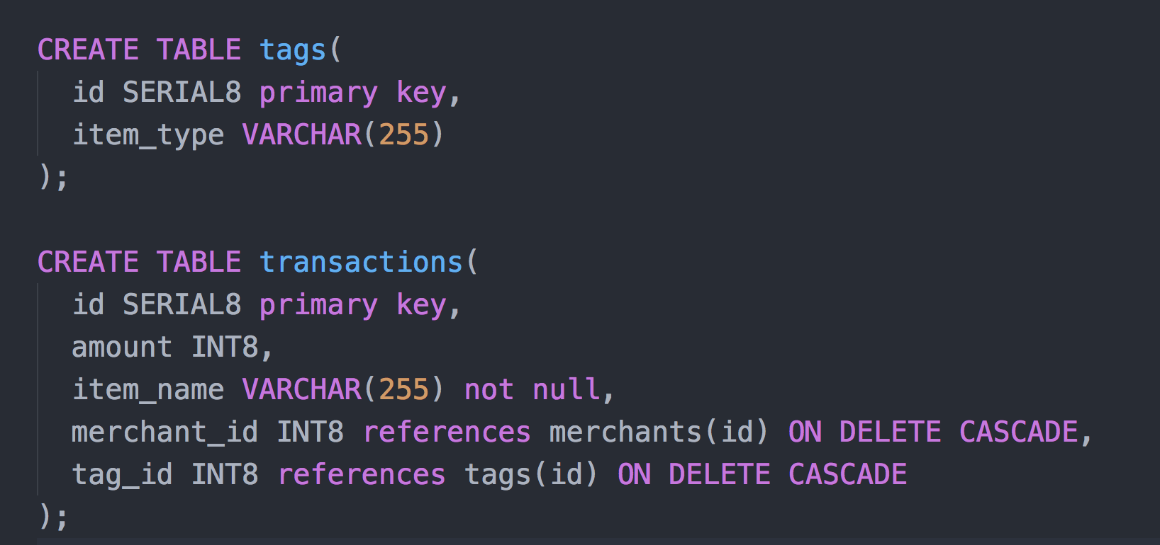
SOLUTIONS CONT.

Slide 15
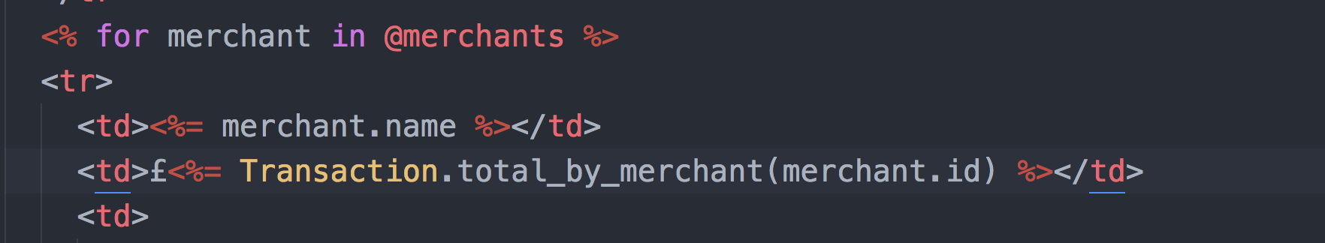
SOLUTIONS CONT.

Slide 16
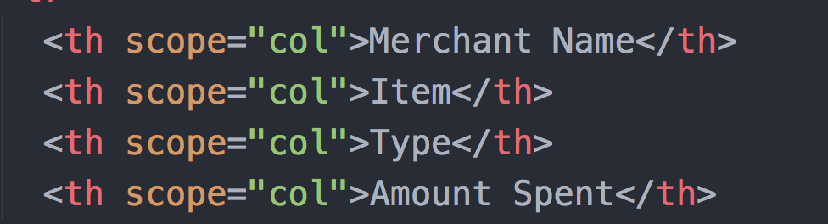
Styling & Accessibility
NO bells & whistles!!!
I tried to make the app as simple and accessible as possible, since previous experience has shown me that the more bells a & whistles you add to a project, the more things there are to go wrong.
In addition the simpler it is, the more accessible it is, so my app looks nice & simple. The colour scheme was chosen with accessibility in mind.
To improve this aspect of the app I wanted to make sure the navigation links were reasonably sized and the header texts clearly visible.
I also included the following column attributes to ensure the column headers were correctly identified for screen readers.

Slide 17
FINISH
SHOW CODE, ETC AND QUESTIONS.

